Slide 1
Milestone –First set of Analysis and Results
SNA Project on DTC Transport Network Analysis
using SNA Techniques
Submission By
Parveen Bajaj, EET182574
Abhishek Bohra, EET182561

Slide 2
Outcomes
Collection of Data
Bus Routes - 737
Bus Stops - 1860
Preparation of Various Topological Spaces
L Space
C Space
P Space
B Space
Questions We tried to answer

Slide 3
Outcomes
How many routes?
How many Bus stops?
Identification of candidate Bus Routes for expressway corridors
Identification of candidate Bus Routes for BRT Service
Bus Depot / Hub Locations
How many bus routes are needed to get from one bus stop to another?
How many maximum routes will we require to move between the two most distant bus stops within the city?
Avg Number of Bus Stops per route.
How many bus stops a person can go by using only one line?
How many bus routes are required to reach 99 % of Bus Stops?

Slide 4
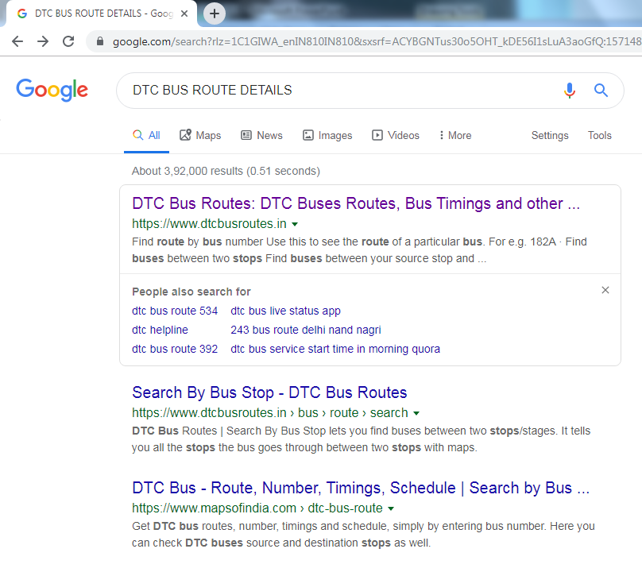
Collection of Data

Slide 5
Collection of Data

Slide 6
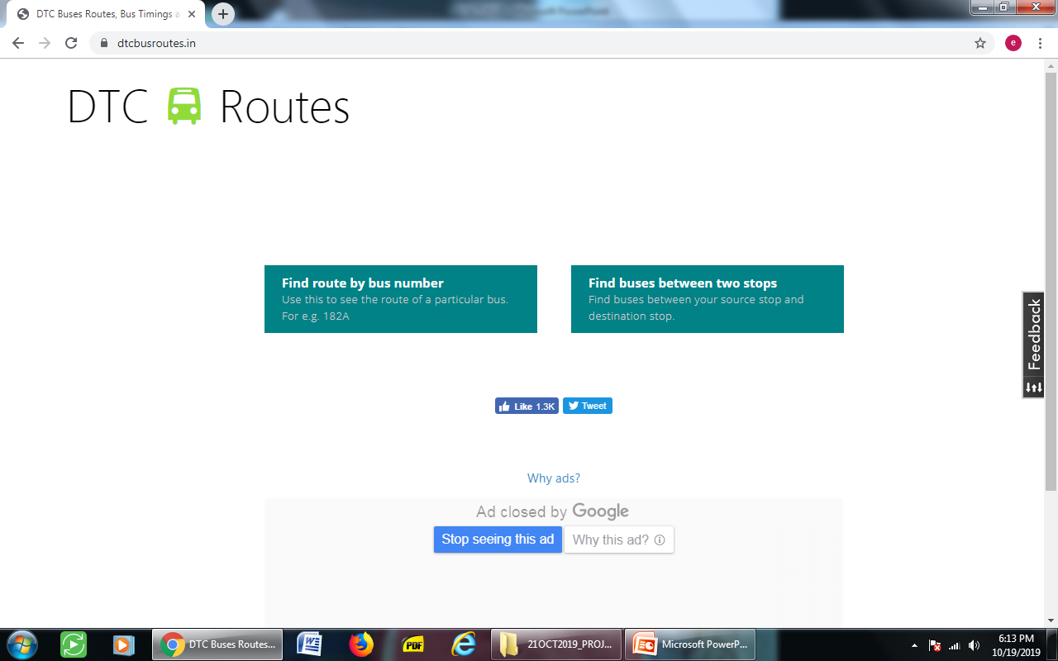
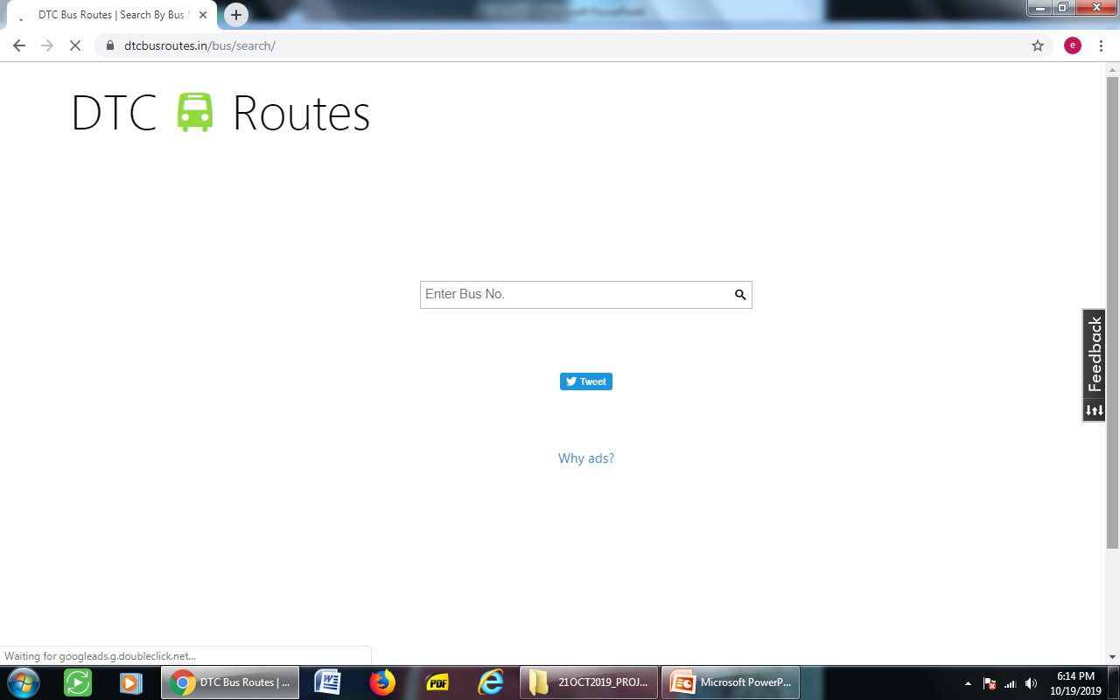
Collection of Data

Slide 7
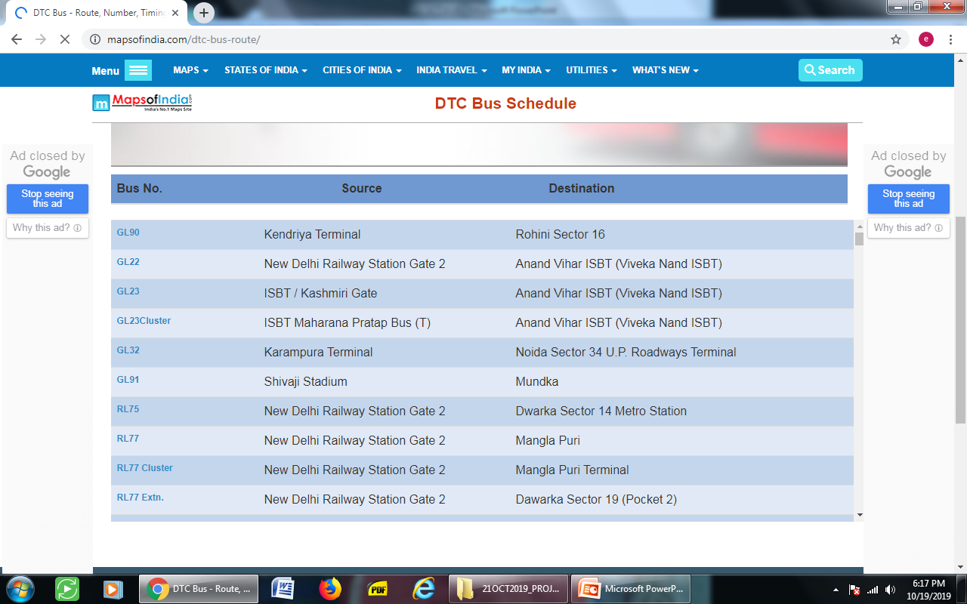
Collection of Data

Slide 8

Collection of Data

Slide 9
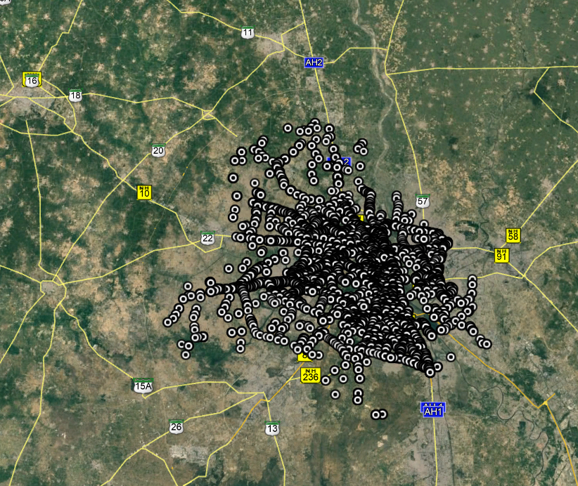
Google Earth View

Slide 10
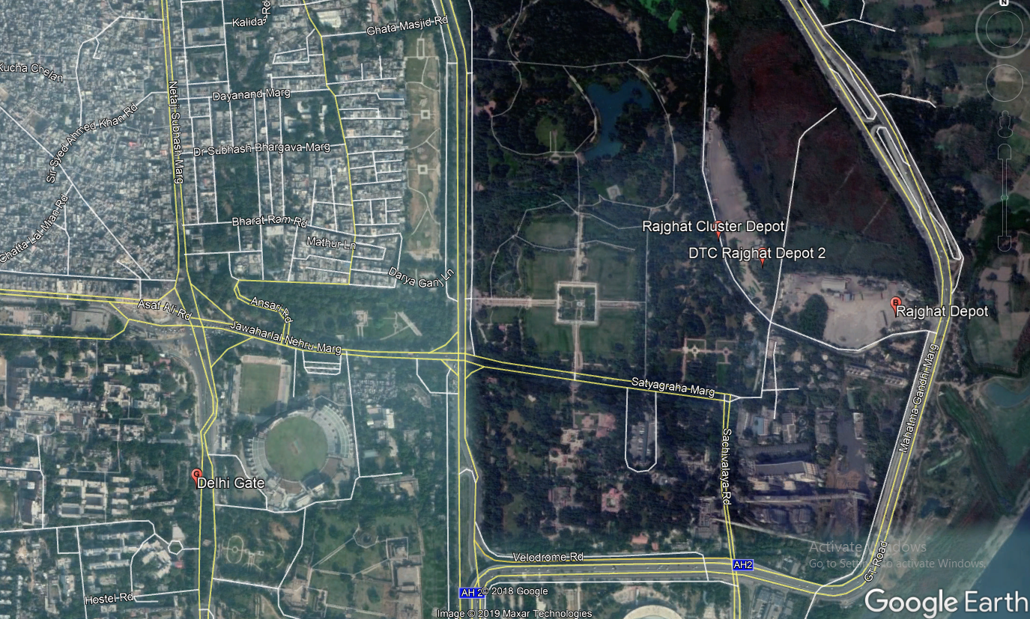

Slide 11
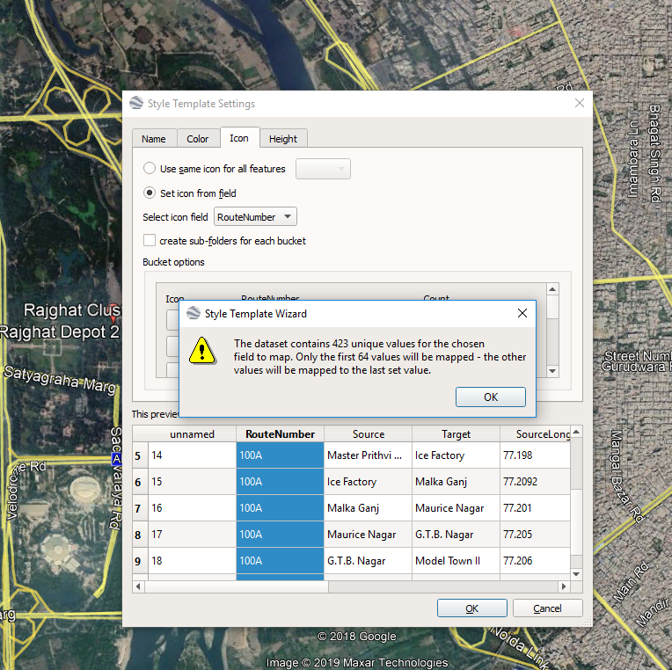

Slide 12
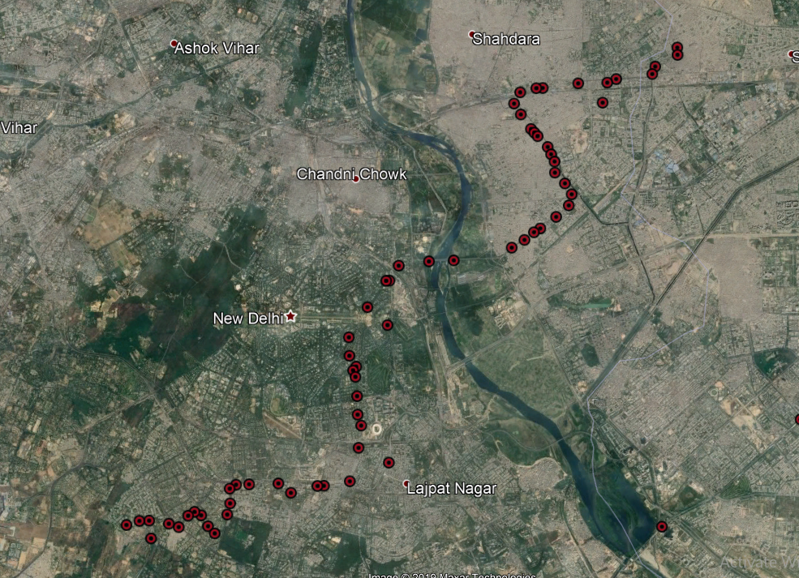

Slide 13
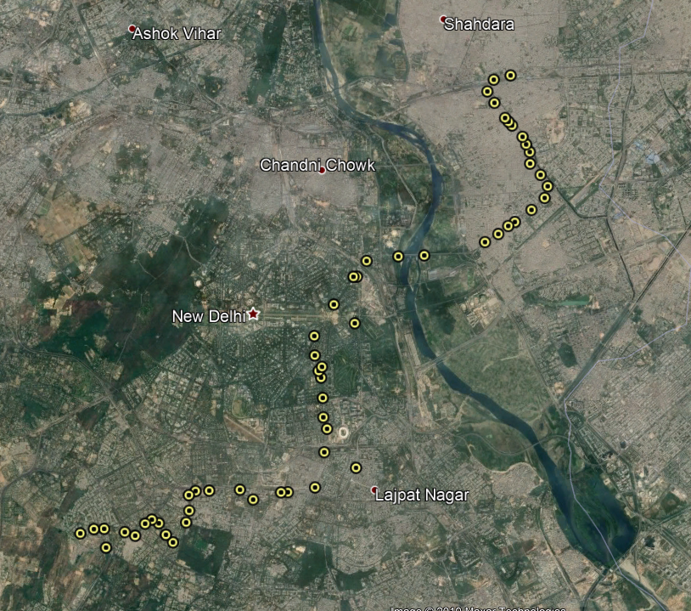

Slide 14
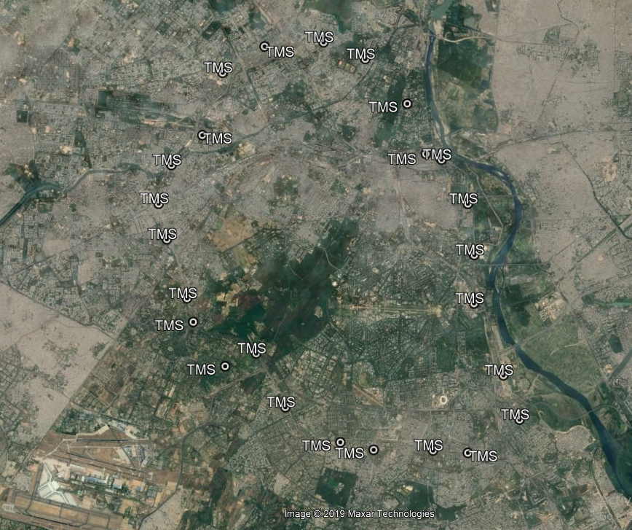

Slide 15
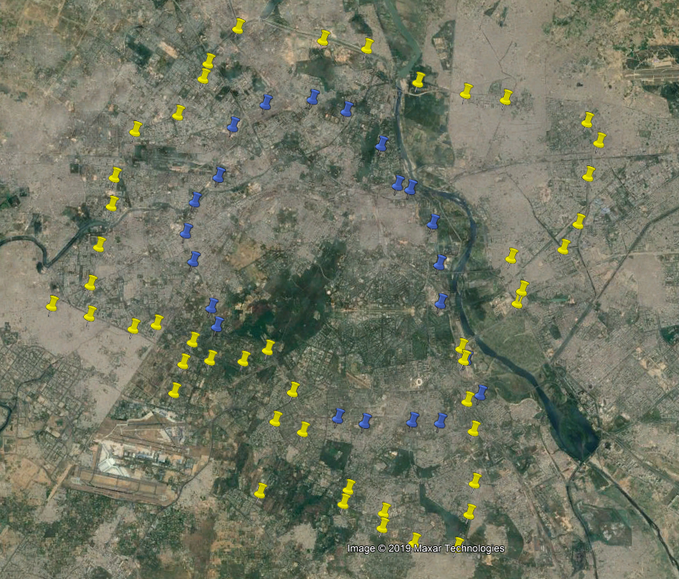

Slide 16
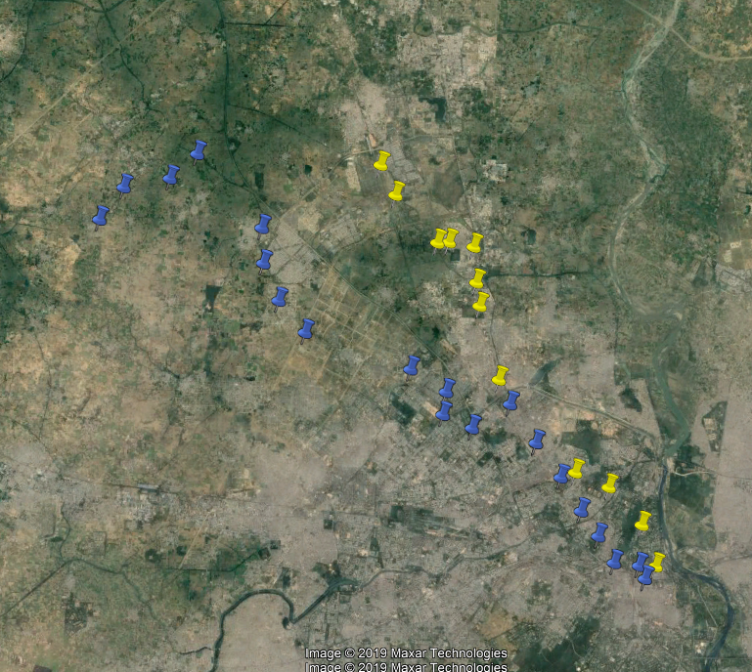

Slide 17
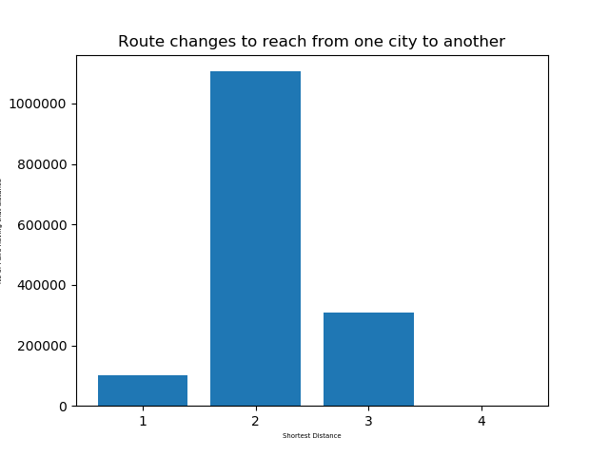
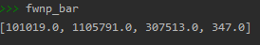

Slide 19
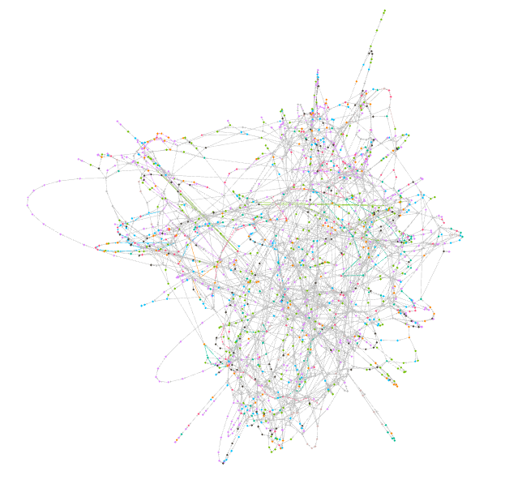
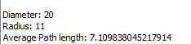
L-Space

Slide 20
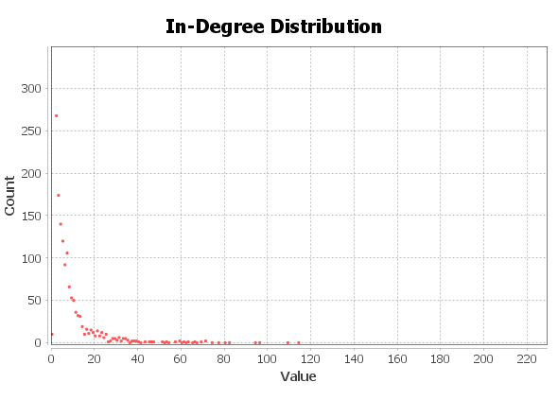
Degree Distribution L Space
As high degree node of L Space is connected to more number of bus stops,
therefore it is a potential candidate for Bus Depots or Hub

Slide 21
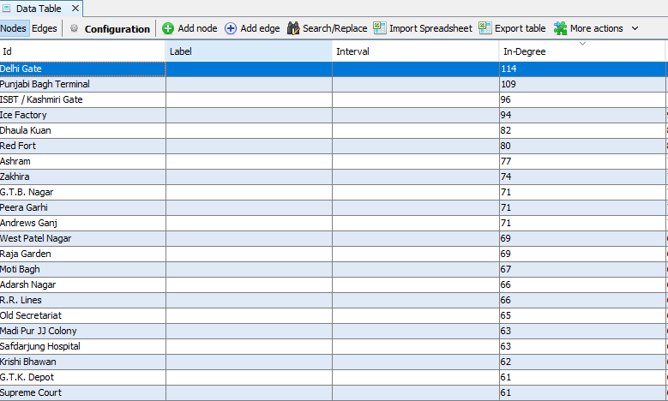
Degree Distribution L Space

Slide 22
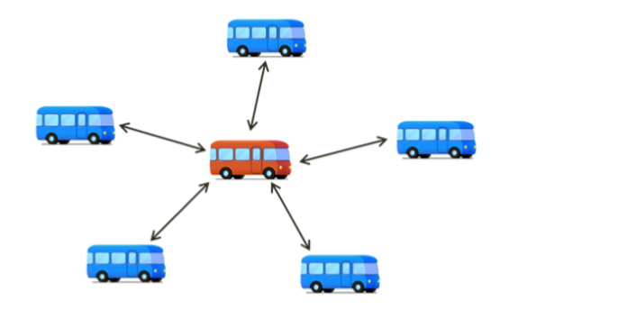
Identification of candidate Bus Routes for Expressway Corridors
Using C Spaces

Slide 23
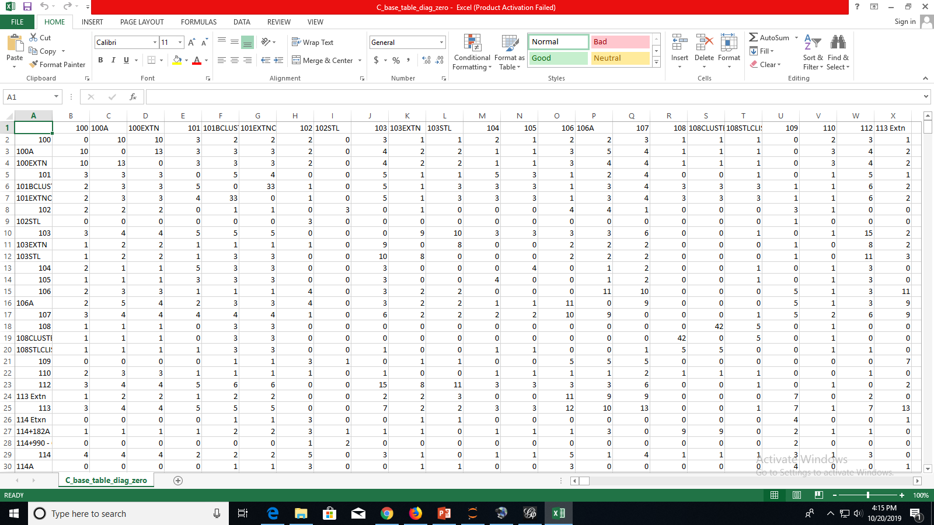
Preparation of C Space

Slide 24
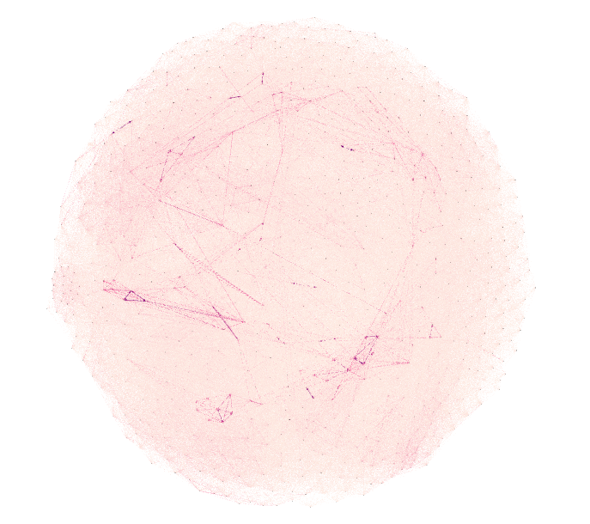
Plot of C Space in Gephi
Nodes:737
Edges: 159992

Slide 25
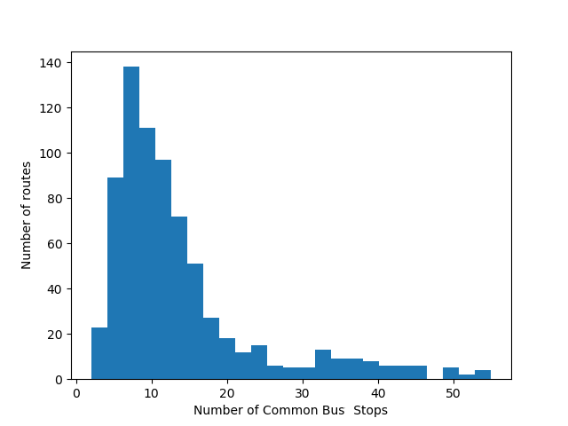
Histogram Plot of C Space

Slide 26
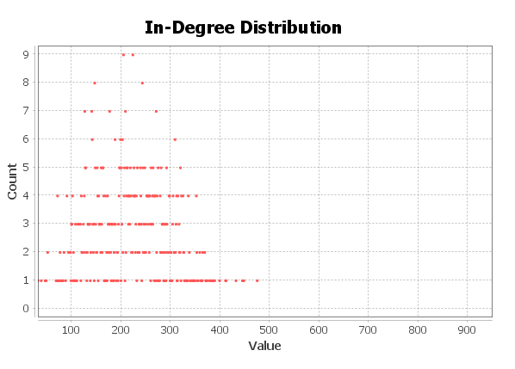
Identification of candidate Bus Routes for Expressway Corridors (How ???)

Slide 27
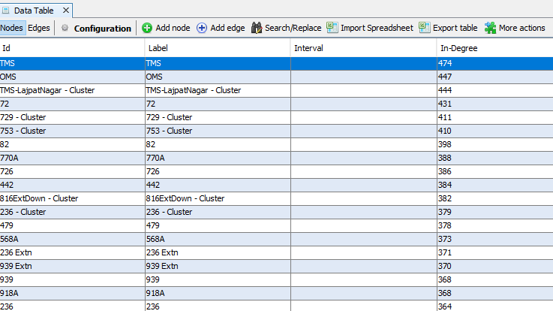
Identification of candidate Bus Routes for Expressway Corridors (How ???)
In C Space, nodes having high degree are best candidate for Expressway Corridors.

Slide 28
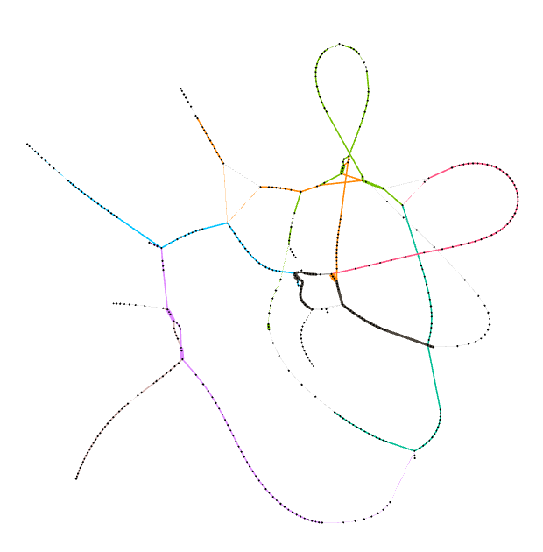

Identification of BRT Routes using Cs Networks
623 Extn: 56
623 Extn Cluster: 67
Cs 55
Cs 43

Slide 29

Identification of BRT Routes using Cs Networks
Bus Route | Number Of Bus Stops
623 Extn | 56
623 Extn Cluster | 67
764 Cluster | 54
764 Extn Cluster | 63
921 CL | 59
921E Cluster | 62
Cs 50

Slide 30
How Many Bus Routes & Bus Stops?
Bus Routes
From Bipartite Graph (B-Space),
Number of Nodes in Bus Routes or Out Degree Nodes
From C Space,
Number of Nodes
Bus Stops
From Bipartite Graph (B-Space),
Number of Nodes in Bus Stops set or In Degree Nodes
From C Space,
Number of Nodes

Slide 31
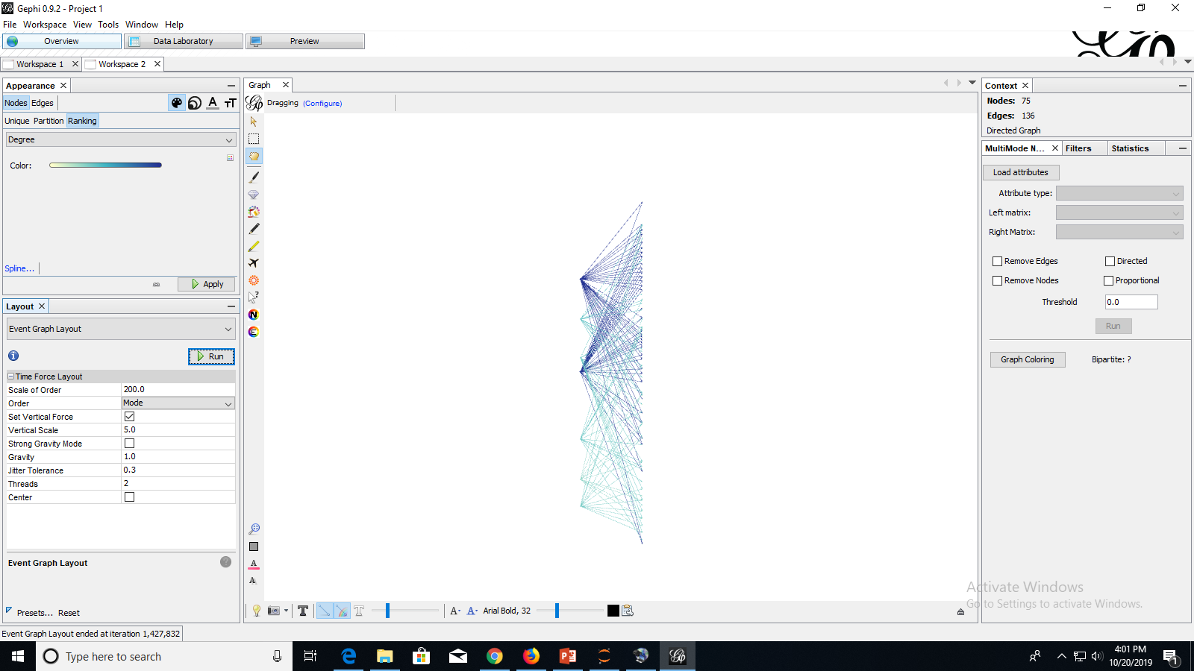
B-Space

Slide 32
Thank You

